Slide 1
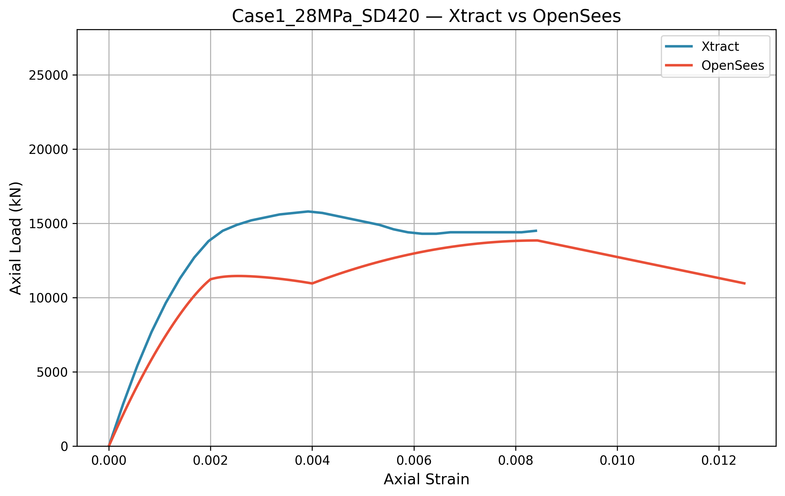

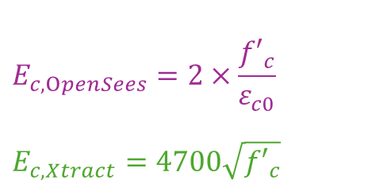
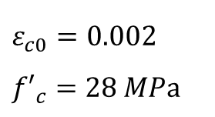

case1
$$E_{OpenSees}$$
$$E_{Xtract}$$
$$E_{c, OpenSees}=2×\frac{{f′}_{c}}{ε_{c0}}$$
$$E_{c, Xtract}=4700\sqrt{{f′}_{c}}$$
$$ε_{c0}=0.002$$
$${f′}_{c}=28 MPa$$

Slide 2
case1
OpenSees: Explicit Fiber Model
Detailed Discretization: Explicitly models Core vs. Cover fibers.
Cover Spalling: Cover strength f’cu drops to 0 at 0.004 strain.
Realistic Response: Successfully captures the physical "dip" in axial capacity.
XTRACT: Algorithmic Smoothing
Numerical Smoothing: Employs integration smoothing for numerical stability.
Uniform Loss: Distributes cover strength degradation across the section.
Stable Curve: Produces a continuous, idealized result without local fluctuations.

Slide 3


case1
1. Capacity Comparison
XTRACT: 16,000 kN
OpenSees: 14,000 kN
Discrepancy: Approximately 12% difference in peak capacity.
2. Technical Justification
Confinement Implementation: Both models utilize Mander’s
OpenSees Modeling: Uses Concrete01, which follows a linear softening path after the peak.
Discrepancy Origin:
XTRACT’s internal confinement algorithm is more aggressive in predicting strength gain.
Concrete01 in OpenSees tends to be more conservative due to its simplified post-peak mathematical definition.
$$16000kN$$
$$14000kN$$

Slide 4
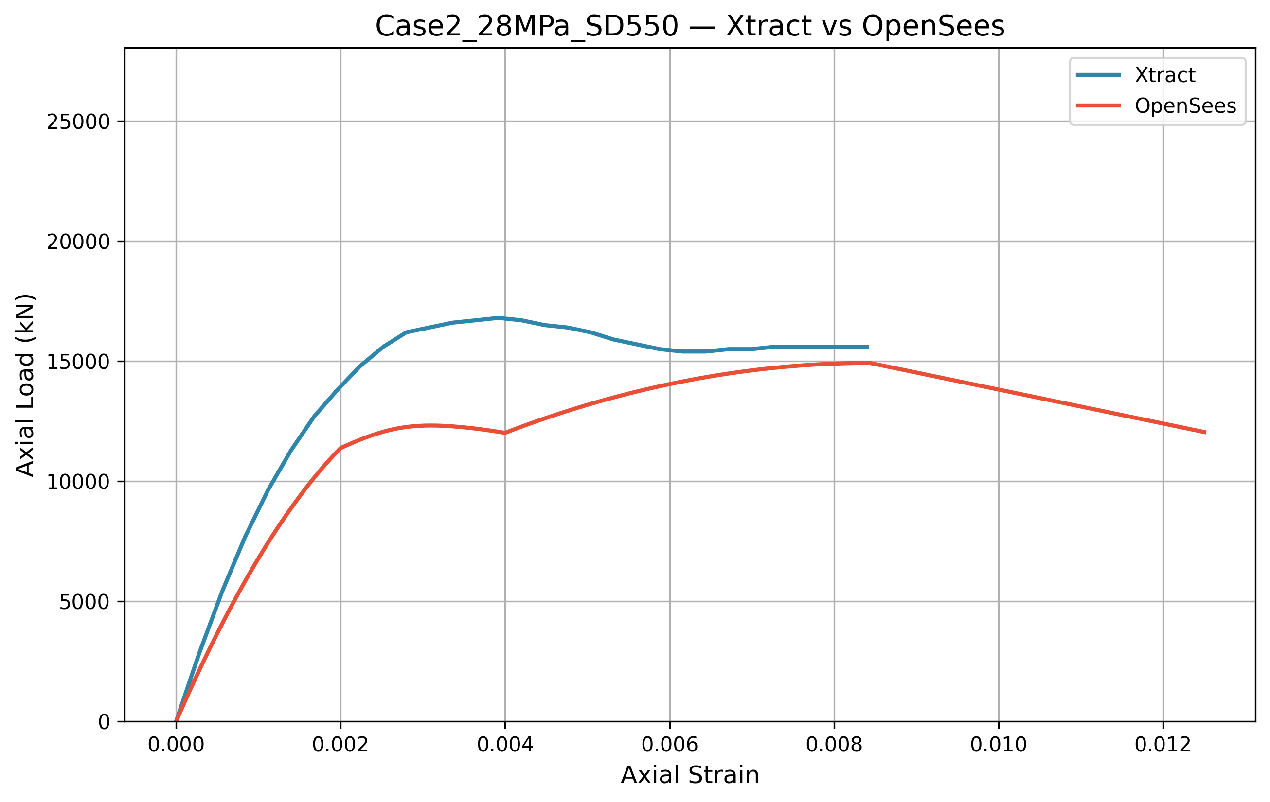
case2
$$E_{OpenSees}$$
$$E_{Xtract}$$
$$E_{c, OpenSees}=2×\frac{{f′}_{c}}{ε_{c0}}$$
$$E_{c, Xtract}=4700\sqrt{{f′}_{c}}$$
$$ε_{c0}=0.002$$
$${f′}_{c}=28 MPa$$

Slide 5
case2
Software Logic Contrast
OpenSees (Physical Reality):
Captures the explicit failure of the concrete shell.
Fiber-based sensitivity reflects the sudden loss of cover capacity.
XTRACT (Idealized Model):
Employs numerical smoothing during integration.
Results in a continuous, "stable" curve that masks localized physical failure.

Slide 6



case2
1. Evolution: Impact of SD550
Second Peak Recovery: Higher steel grade (f_{y} = 550MPa) enables a stronger strength recovery after spalling.
Hardening Sensitivity: Unlike XTRACT's idealized curve, OpenSees captures significant strength gains as the 16-D25 bars enter the hardening region.
2. Software Comparison
XTRACT: Remains "Aggressive" on peak strength but masks local failure.
OpenSees: Conservative on initial stiffness but superior in capturing late-stage ductility and hardening.
$$16800kN$$
$$14900kN$$

Slide 7
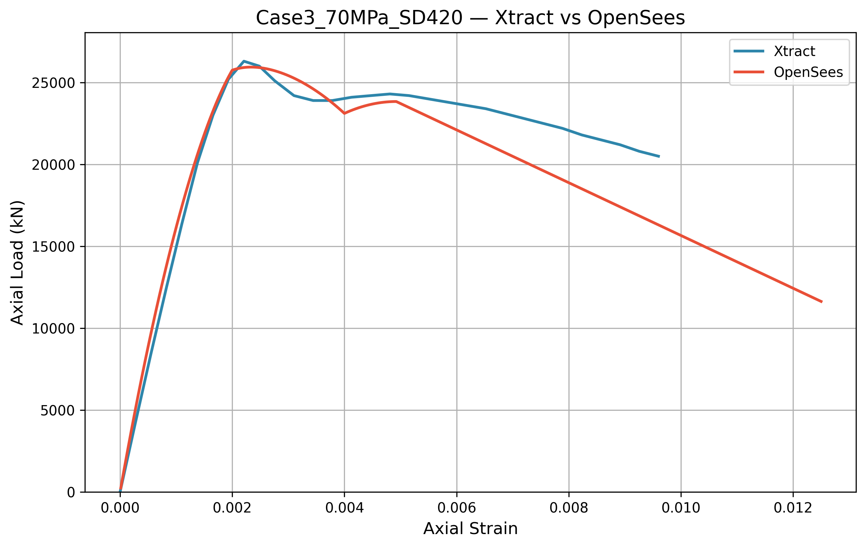

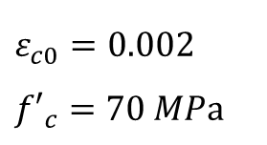

case3
$$E_{OpenSees}$$
$$E_{Xtract}$$
$$E_{c, OpenSees}=2×\frac{{f′}_{c}}{ε_{c0}}$$
$$E_{c, Xtract}=4700\sqrt{{f′}_{c}}$$
$$ε_{c0}=0.002$$
$${f′}_{c}=70 MPa$$

Slide 8
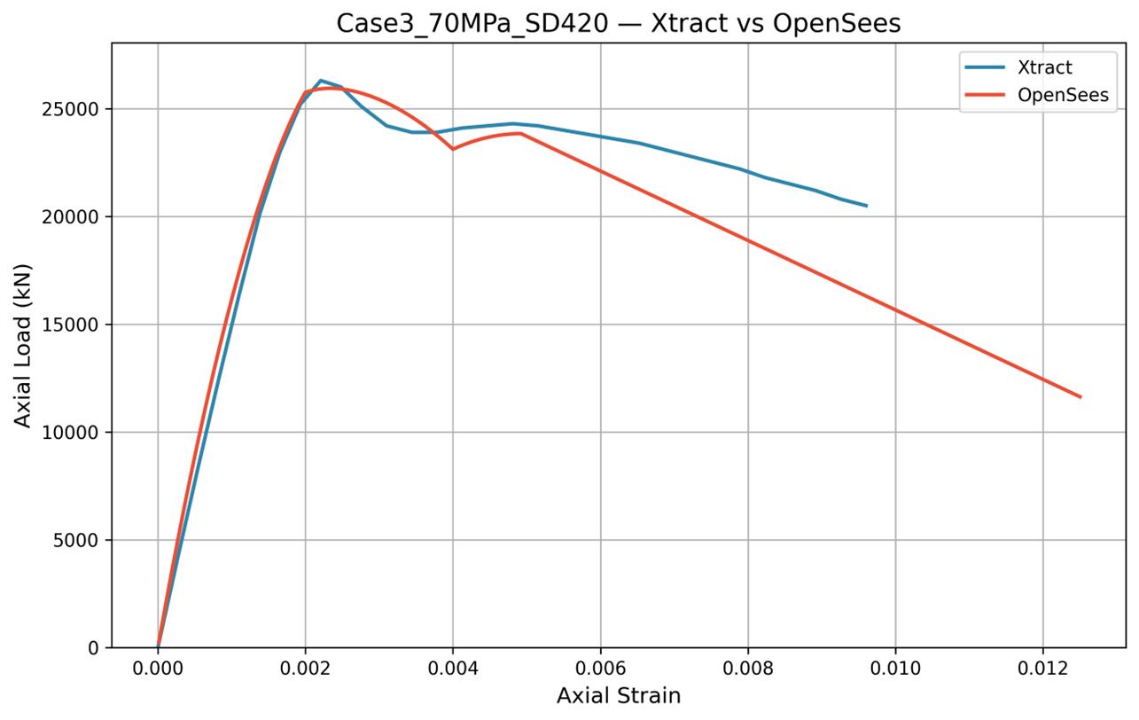

case3
1. Observation
Sharp & Deep Drop: OpenSees exhibits a more dramatic load reduction compared to 28MPa cases.
Brittle Failure: The curve reflects the sudden nature of high-strength concrete failure.
2. Technical Causes
Material: 70MPa concrete is more brittle than 28MPa.
Explicit Spalling: The OpenSees script terminates cover strength at 0.004 strain.
Massive Load Loss: Because the 70MPa cover layer carries a much higher axial load, its sudden failure leads to a "falling off a cliff" effect.
3. Software Logic
OpenSees: Captures the physical reality of a brittle spalling through explicit fiber failure.
XTRACT: Uses numerical smoothing, which masks this sharp physical transition.
$$\text{Drop}$$

Slide 9
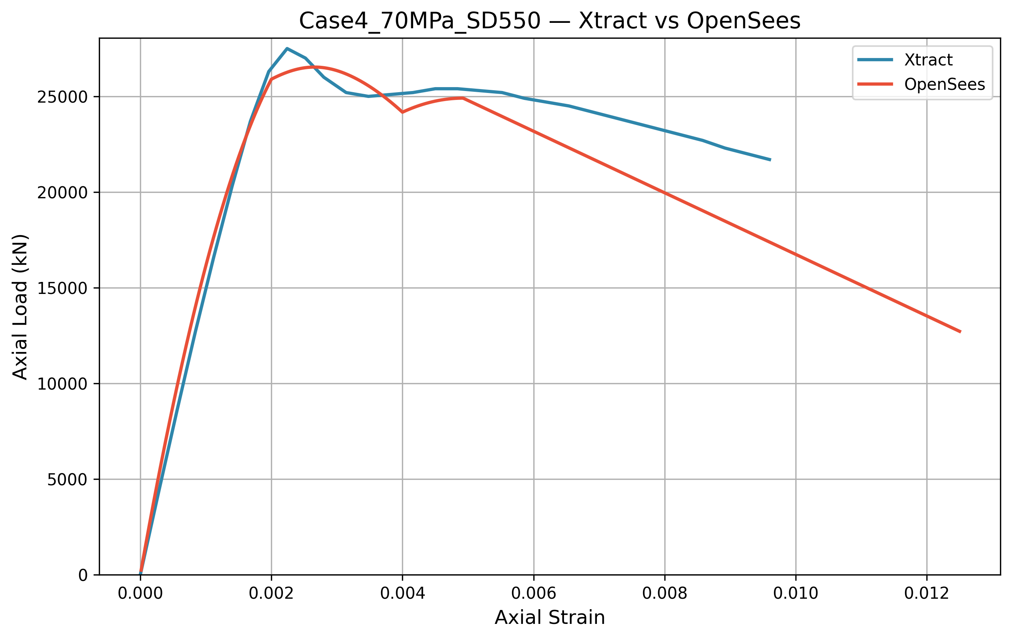
case4
$$E_{OpenSees}$$
$$E_{c, OpenSees}=2×\frac{{f′}_{c}}{ε_{c0}}$$
$$E_{c, Xtract}=4700\sqrt{{f′}_{c}}$$
$$E_{Xtract}$$
$$ε_{c0}=0.002$$
$${f′}_{c}=70 MPa$$

Slide 10
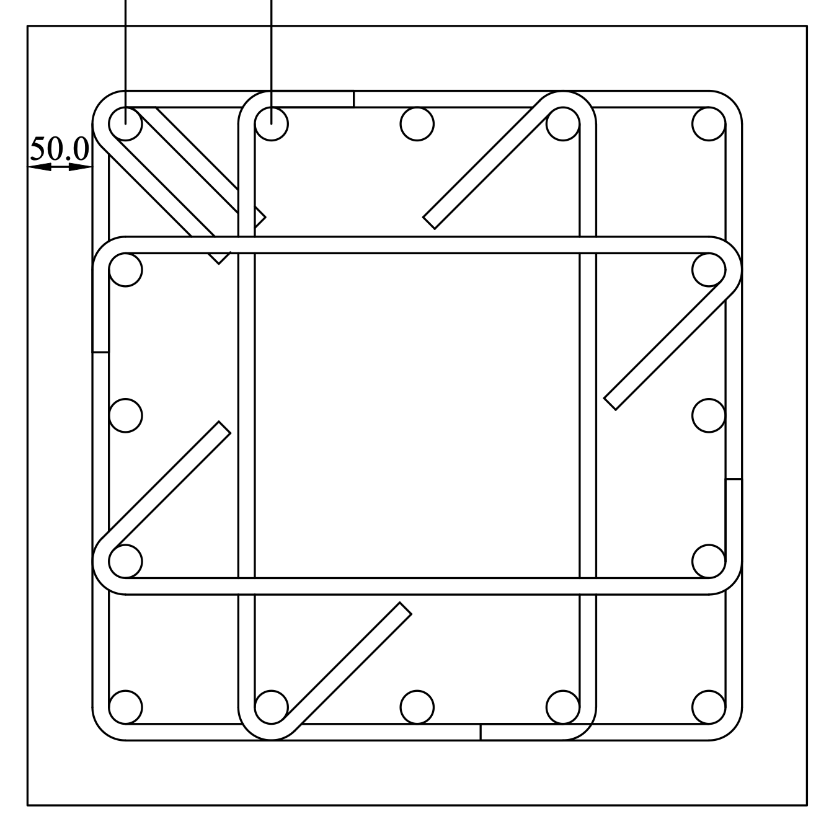
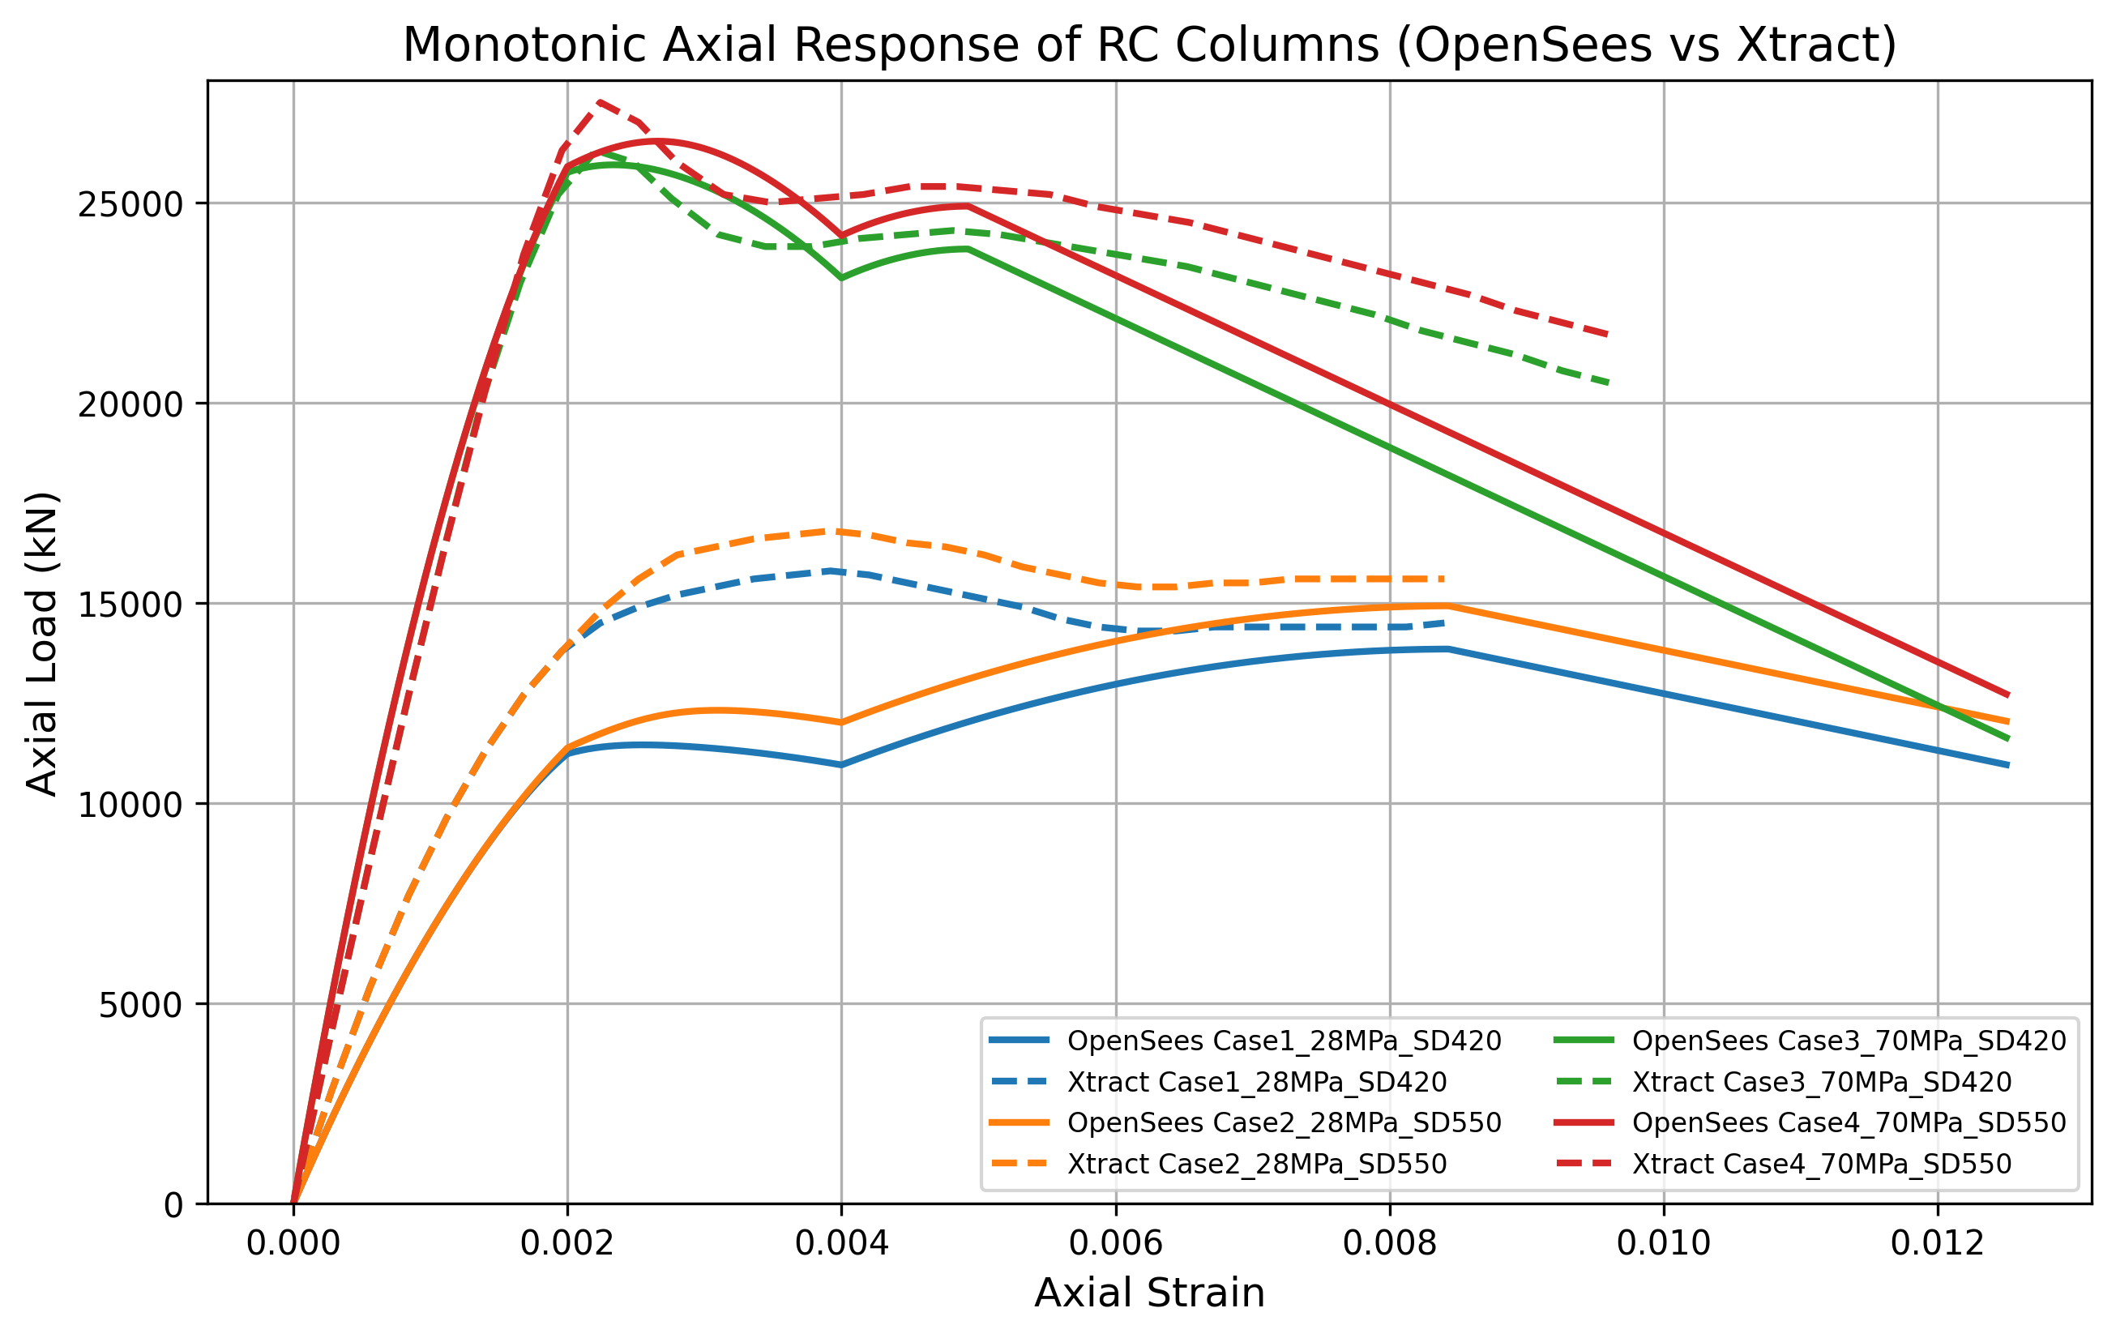


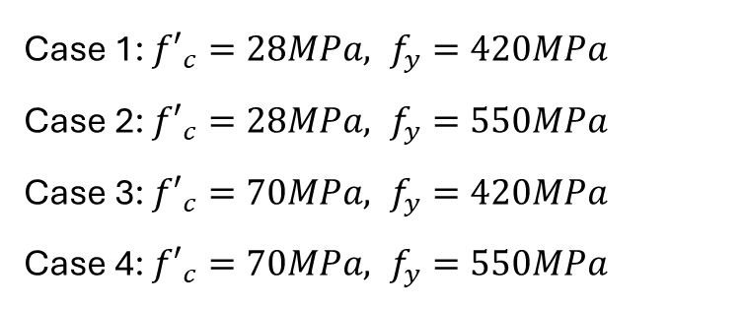
Summary
Case 1: ${{f′}_{c}=28MPa, f}_{y}=420MPa$
Case 2: ${{f′}_{c}=28MPa, f}_{y}=550MPa$
Case 3: ${{f′}_{c}=70MPa, f}_{y}=420MPa$
Case 4: ${{f′}_{c}=70MPa, f}_{y}=550MPa$
Vs.

